Slide 1
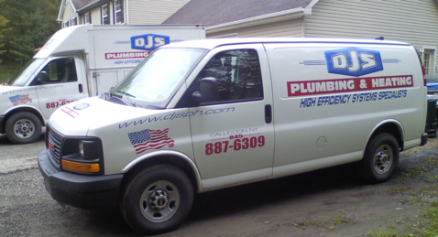

Oil - 550 Gallon Tank
Service?
Cleaning?
Delaware Valley Oil
http://dvoil.com
Phone (845)-887-6090
Office: M-F 8am-4pm
3 Bridge Street, Callicoon, NY 12723
P.O. Box 838 Callicoon NY 12723
Email delawarevalleyoilllc@yahoo.com
Email: LeanaStanton@aol.com
Owner wife: Casey Milk
Truck driver: Larry, Kevin
Brian
845-645-9403 cell
Plumber
(Boiler/Filter mainenance)
2022-07-06: ordered 150 gal ($5.79/gal) = $868.50
2022-11-22: ordered 150 gal ($5.59/gal) = $838.50
2023-01-07: gauge reading: 1/4 = 108 Gal
2023-01-07: ordered 150 gal ($4.29/gal) = $643.50
2023-01-14: gauge reading: 1/2 = 275 Gal
2023-02-05: gauge reading: 3/8- = 175 Gal
2023-02-10: ordered 250 gal ($4.19/gal) = $1,047.50
2023-02-11: gauge reading: 3/4+ = 455 Gal
2023-05-30: ordered 200 gal ($3.52/gal) = 465 gal
2024-01-07:gauge reading:1/4+(120 gal)
2024-01-11: ordered 331.6 gal @ $3.86/gal – full
2024-07-16: ordered 300 gal @ $3.76
DJS Plumbing and Heating
Doug Santoro
(845) 887-6309 office
(845) ... mobile
email: djsph@hvc.rr.com
.. https://www.djsph.com
.. https://www.facebook.com/DJSPlumbingHeating/
.. 9 Del Vue Rd, Callicoon, NY 12723
.. 4-6 weeks waiting for scheduled service
Hook Well Drilling. 570-224-....
Head Electric Plumbing & Heating, Inc
(845) 807-7676
4499 St Rt 17B, Callicoon, NY 12723
pat costello plumbing PA. 570-224-....

Slide 2
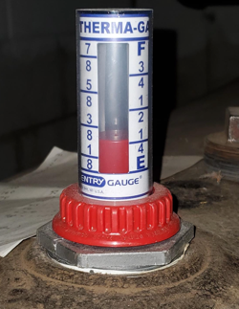
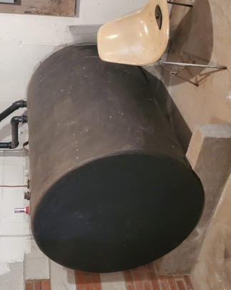
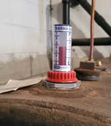
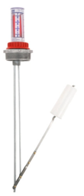
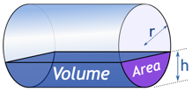
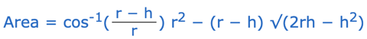
Oil Tank 48" diameter, 550 gal
inch | part | part | gals | inch | part | part | gals
1 | 0.02 |  | 3 | 25 | 0.52 |  | 290
2 | 0.04 |  | 8 | 26 | 0.54 |  | 304
3 | 0.06 |  | 14 | 27 | 0.56 |  | 319
4 | 0.08 |  | 22 | 28 | 0.58 |  | 333
5 | 0.10 |  | 30 | 29 | 0.60 |  | 347
6 | 0.13 | 1/8 | 40 | 30 | 0.63 | 5/8 | 362
7 | 0.15 |  | 50 | 31 | 0.65 |  | 376
8 | 0.17 |  | 60 | 32 | 0.67 |  | 390
9 | 0.19 |  | 71 | 33 | 0.69 |  | 403
10 | 0.21 |  | 83 | 34 | 0.71 |  | 417
11 | 0.23 |  | 95 | 35 | 0.73 |  | 430
12 | 0.25 | 1/4 | 108 | 36 | 0.75 | 3/4 | 442
13 | 0.27 |  | 120 | 37 | 0.77 |  | 455
14 | 0.29 |  | 133 | 38 | 0.79 |  | 467
15 | 0.31 |  | 147 | 39 | 0.81 |  | 479
16 | 0.33 |  | 160 | 40 | 0.83 |  | 490
17 | 0.35 |  | 174 | 41 | 0.85 |  | 500
18 | 0.38 | 3/8 | 188 | 42 | 0.88 | 7/8 | 510
19 | 0.40 |  | 203 | 43 | 0.90 |  | 520
20 | 0.42 |  | 217 | 44 | 0.92 |  | 528
21 | 0.44 |  | 231 | 45 | 0.94 |  | 536
22 | 0.46 |  | 246 | 46 | 0.96 |  | 542
23 | 0.48 |  | 260 | 47 | 0.98 |  | 547
24 | 0.50 | 1/2 | 275 | 48 | 1.00 | "1" | 550
Calculator:
https://www.mathsisfun.com/geometry/cylinder-horizontal-volume.html
Krueger Sentry Therma Tank Gauge
https://www.jmesales.com/krueger-sentry-type-h-2-in-galvanized-therma-tank-gauge/

Slide 3

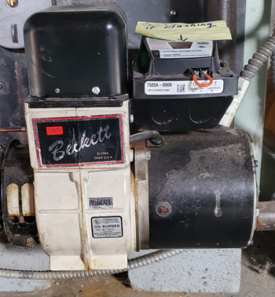
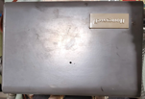
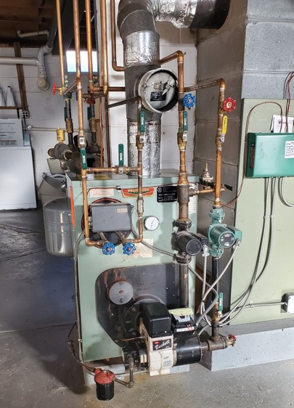
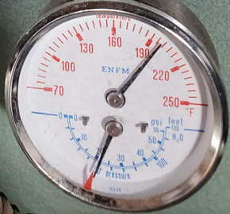
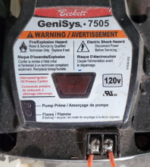
Peerless Boiler WB-3 Series (WBV-110-WPD ?)
residential, oil-fired boilers
https://www.peerlessboilers.com
https://www.peerlessboilers.com/products/series-wbv/
https://www.youtube.com/watch?v=5GbXgEYw5TE
12-18 Gal of water
Peerless Boiler WB-3 Series
Honeywell Boiler Aquastat Model L8124C1102
Becket AFG Oil Burner
Beckett GeniSys™ 7505A control unit
Allanson Oil Burner Ignition Transformer 2721-628g
Nozzle: "00085-80B1" or .85-80B
0.85 - flow rate, 80 degrees spray angle, B - spray pattern (solid cone)
Honeywell boiler aquastat (thermostat)
Model L8124C1102
sends "more heat" signal to 7505 burner control unit
Becket AFG Oil Burner
Beckett GeniSys™ 7505A control unit
Specific model 7505A
Beckett GeniSys™ 7505 oil burner control https://www.beckettcorp.com/product/genisys-7505-oil-burner-control/
used with a suitable cad cell flame sensor to control the oil burner motor, igniter, and optional solenoid valve
has 24 VAC thermostat terminals
can provide interrupted or intermittent duty ignition, and it has a 15 second lockout time

Slide 4
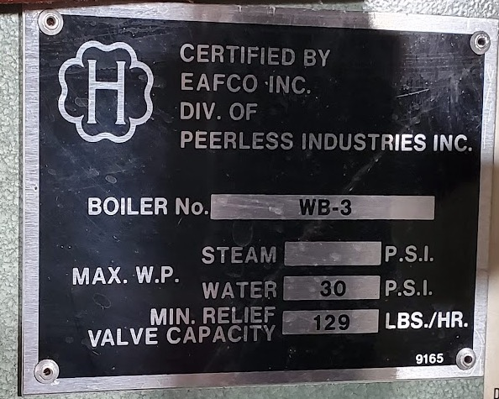
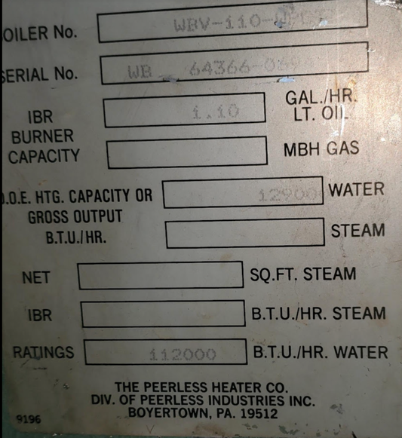
Boiler
https://www.peerlessboilers.com
https://www.peerlessboilers.com/products/series-wbv/
Water Pressure in kitchen sink – 40-60 PSI
Water Pressure in house heating should be low (15 psi ?)
Test – time to fill a 5 Gal bucket
(20 sec – excellent, 60 sec – fine)

Slide 5
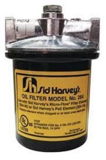
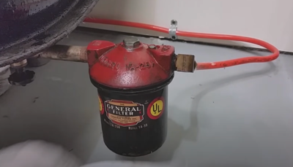
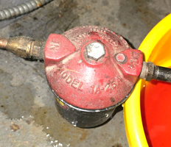
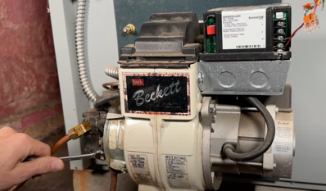
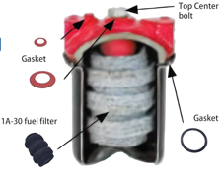
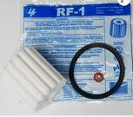
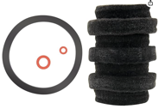
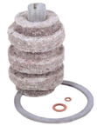
(Re) Starting Boiler
Oil Heat Boilers - How it works - the Basics
https://www.youtube.com/watch?v=5GbXgEYw5TE
Oil Heat Boilers - How it works - Understand the Basics
https://www.youtube.com/watch?v=5GbXgEYw5TE
How To Prime and Restart an Oil Heater After Oil Is Empty
https://www.youtube.com/watch?v=YMvrSXqZdiQ
How to bleed oil burner, restart, re-light the furnace
https://www.youtube.com/watch?v=gZcPUH83S10
Plugged Oil Line to Boiler Furnace and Filter Change DIY
https://www.youtube.com/watch?v=tj_3pXc2rZM
How to bleed the oil furnace
https://www.youtube.com/watch?v=DFY10lAQM28
Oil furnace troubleshoot part 4 no oil to burner
https://www.youtube.com/watch?v=NT6mMApZES0
Setting electrodes and replacing nozzle
https://www.youtube.com/watch?v=N6i2x08oI4o
Common Burner Issues and How to Fix Them
https://www.youtube.com/watch?v=svP6khjS1xQ
1A-25A filter housing – older model (that we have).
1A-25B – newer model, has epoxy coating on the inside of the housing to prevent corrosion caused by contaminants in the oil.
S264 – yet another compatible cartridge
All above housings use the same filters/cartridges.
General 1A-30. Search for "Replacement for 1a-30 Fuel Oil Heat Filters Cartridge" on amazon, etc.
Typically 10-micron Wool Felt Filters
How to Replace An Oil Filter For Your Oil Fired Boiler Or Furnace
https://www.youtube.com/watch?v=yx9g9P_z5So
How To Restart An Oil Furnace | Hard Lockout and Bleeding Fuel Lines
https://www.youtube.com/watch?v=TUKQ02AVtz0

Slide 6
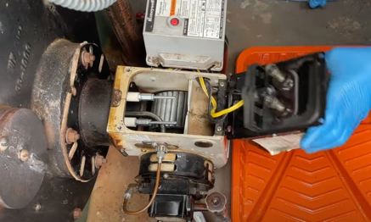
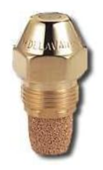
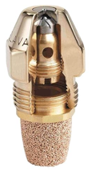
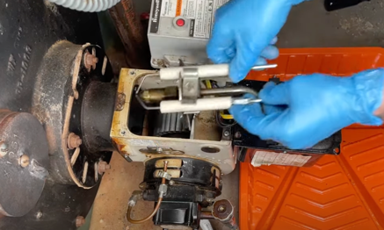
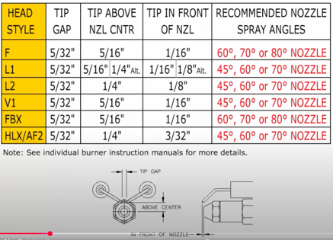
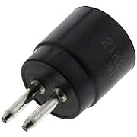
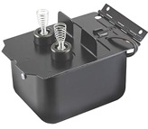
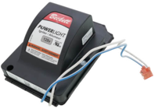
Replacing Nozzle
Nozzle: "00085-80B1" or .85-80B
0.85 - flow rate (in gal/hr at 100PSI)
80 - spray angle of the nozzle (degrees)
B - spray pattern (solid cone)
https://www.amazon.com/gp/product/B000VB6C5K/
https://www.youtube.com/watch?v=dCtwGjH8gcw
shut-off electrical switch for the boiler
shut the oil line off
unscrew 2 screws and pivot black transformer box
disconnect oil metal tube
take out electrodes' assembly (careful not to spill oil)
degrease everything
unscrew – and change the nozzle
position tips of electrodes properly
assemble back
Honeywell 120320 Cad Cell
https://www.amazon.com/gp/product/B004P646DC/
Allanson Oil Burner Ignition Transformer 2721-628g
https://www.amazon.com/dp/B082J42D88/
Beckett 51771u
PowerLight Igniter
(modern drop-in replacement for an ignition Transformer)

Slide 7
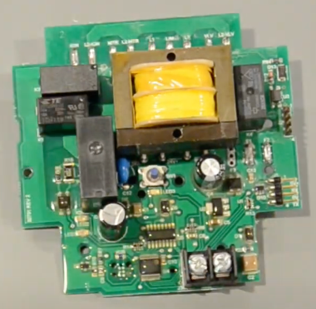
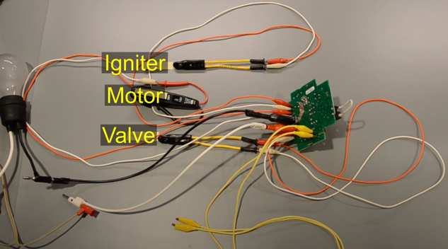
Troubleshooting Beckett Genisys 7505
Google for:
Genisys 7505 won't start after power outage
Video troubleshooting the 7505
.. https://www.youtube.com/watch?v=Wd7vrkUDaz4
Checks for flame presence
Ignites – and checks that it is ignited
reacts to signal "more heat" to start/stop blower (and shut off the valve)

Slide 8
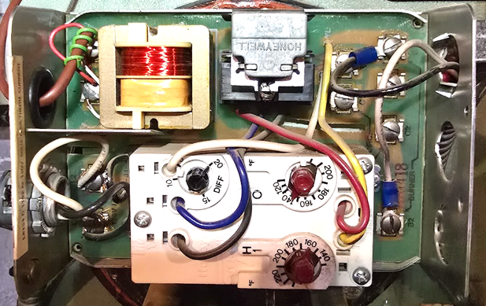
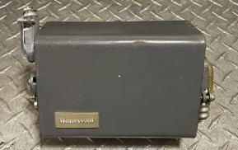
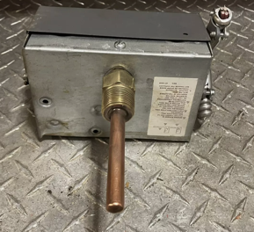
Honeywell Aquastat
Honeywell Boiler Aquastat
Model L8124C1102
The aquastat has a temperature-sensing element.
It has a 120V/24V AC transformer
It has electronic relays for burner and "circulator pump" circuits:
.. Activate the burner to heat the water if T is too low
.. Shut off the boiler at high water temp.
.. Turn on the circulator pump when T is high enough

Slide 9
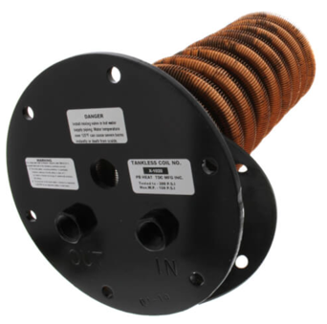
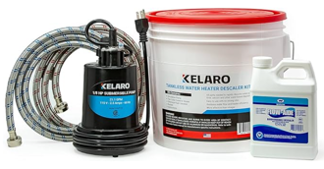
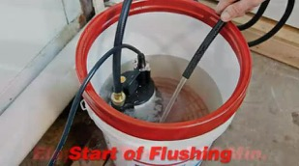
Cleaning Hot Water Coil
Peerless Boiler WB-3 Series heats a tank of water on top of its furnace.
Tap water is heated by passing through a coil inside this hot water tank: Tankless Coil 90534 (approx $600)
If you have low hot water pressure - the coil needs to be cleaned (every 6-12 months) by flushing it "in place" using a mix of water and cleaner (vinegar).
There are convenient kits for doing this on amazon (bucket, hoses, pump):
https://www.amazon.com/dp/B085BF89QJ
https://www.amazon.com/dp/B0C2PJSY8S
There are multiple videos on YouTube showing the process
https://www.youtube.com/watch?v=jVMCLRqAJoc
https://www.youtube.com/watch?v=Raxo-PrlYvo

Slide 10
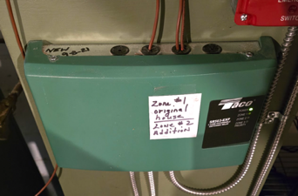
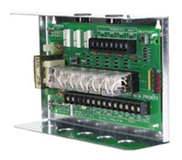
Taco SR503-EXP Switching Relay
Taco SR503-EXP is a 3 zone expandable switching relay (bought Sept 2021)
The Taco SR503-EXP is a switching relay used in hydronic heating systems. Here's a breakdown of its key functions
Inputs – from thermostats, ...
Output relays – send voltage to operate valves and circulator pumps for (multiple) heating zones in the building.
External red lights signal which zone is "working" (circulating).
The "-EXP" designation indicates that it's expandable, meaning it can be connected with other Taco SRs to control more zones
TACO-SR503 allows a designated zone (#3) to take priority over others.
When the priority zone calls for heat, and the priority setting is enabled, the TACO-SR503 can be configured to temporarily shut down the other heating zones.
Priority Protection: To prevent any single zone from monopolizing the boiler indefinitely, the TACO-SR503 often includes a "priority protection" feature which limits the duration of the priority zone's control.
Demo: https://www.youtube.com/watch?v=LzMiW4gNdQo

Slide 11
Oil Burner Yearly Service & Clean
https://www.youtube.com/watch?v=g2nTv1NRuY4
The main procedures from this video are:
Cleaning the oil steam oil boiler
Changing the filters, nozzle, and strainer in the pump
Checking the electrodes
Making sure everything is clean
Checking the CO2 draft and smoke
Making sure the boiler runs good
Taking off the smoke pipe
Cleaning the combustion chamber
Adjusting the electrodes
Purging the air out of the lines
Checking the safety
Checking the stack temp
Doing a smoke test
Doing a CO2 test

Slide 12
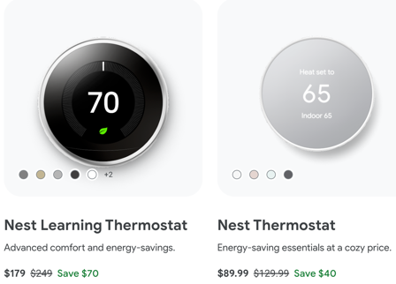

Google Nest Thermostat - 1
Google Nest Thermostat:
.. https://store.google.com/us/product/nest_thermostat
Nest Wifi requires a Nest Wifi router (or Google WiFi)
Latest - Nest Wifi Pro router ($200)
The devices are controlled using Google Home App
https://www.cnet.com/home/internet/nest-wifi-vs-nest-wifi-pro-wi-fi-6e-mesh-routers/
https://www.doityourself.com/forum/thermostatic-controls/602985-connecting-nest-thermostat-genisys-7505-oil-burner.html
https://www.youtube.com/watch?v=WFDPWIKKBHY
.. https://store.google.com/us/widget/compatibility/thermostat
Google Nest thermostats are designed to work with most 24 V systems, even older systems
Online Compatibility Checker: .. https://support.google.com/googlenest/answer/9246656
Nest Learning Thermostat is more compatible
Older Regular Nest Thermostat may need C wire or Nest Power Connector
We have the latest Nest Learning Thermostat (3rd generation) I was following youtube videos and online guides, for example:
.. https://support.google.com/googlenest/answer/9248184 - docs .. https://support.google.com/googlenest/answer/9373007?hl=en – PDFs
.. https://www.youtube.com/watch?v=rdfUbAZi7k0 – missing manual .. https://www.youtube.com/watch?v=7SzjOU30AYg - How to Use ... .. https://www.youtube.com/watch?v=iXi8asdsXTM – How to Use ... for beginners .. https://www.youtube.com/watch?v=AdGDXpb4VzE - How to Use and Program ... .. https://www.youtube.com/watch?v=iKcSKpR9KAM - How to Make Nest Thermostat Manual
(remove learning automation parts)
Note about Nest Learning Thermostat.
It has many settings to automatically adjust temperature based on history, etc.
I turned them all off because it was overriding my wishes. For example, we had two bedrooms with thermostats. Last several weeks we had visitors and were using both bedrooms. This week we using only one, so I decreased the thermostat setting to 56F. But it by itself warmed up to 68F.

Slide 13

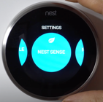
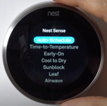

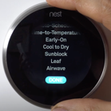
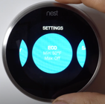
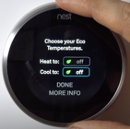
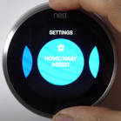

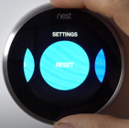
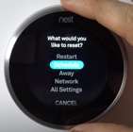
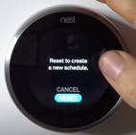

Google Nest Thermostat - 2
Go to Settings
Nest Sense
Auto Schedule
No (to learning)
DONE
How to Make Nest Thermostat Manual
.. https://www.youtube.com/watch?v=iKcSKpR9KAM
ECO
off both
Home Away Assist
STOP Using ECO
RESET
Schedule
Reset
Turn right to reset

Slide 14
Google Nest Thermostat - 3
Nest Thermostat Loses WiFi Randomly
https://www.youtube.com/watch?v=eM_2CXz45RE
Check WiFi stability and speed
Turn router off for 30 sec – and then turn on again
Check that battery level > 3.6V
Reset-Restart the Thermostat
After restarting check Network settings in the Thermostat
ping speed should be < 1500 ms
ping speed == 0 – no communication with server
signal strength should be > 50
Reset Network Settings
Install updates on your Thermostat
Install updates on phone app
Use the interactive Guide: https://widgets.nest.com/nest-thermostat-troubleshooter/
Contact Google Nest Help: Twitter @GoogleNestHelp

Slide 15




Water Heaters:
Selecting a New Water Heater
https://www.energy.gov/energysaver/selecting-new-water-heater
Heating the house (~15 psi) – Oil Boiler
small (12-18 Gal) water camera
low water pressure (below 15-30 psi)
Tankless water heater
is better than storage tank:
never run out of hot water
efficient and economical
maintenance once per year
can last 20+ years
Heating water in sinks and showers (40-60 psi)
Tankless - water passes through coil which is heated by the natural gas furnace
Storage water heater – has 50-80 gal tank heated by natural gas, electric, hybrid (electric direct + compressor), or indirect (heated by hot water from boiler). Usually has a thermal insulation and a thermostat
Tankless water heater:
Storage water heater:

Slide 16





Water Heaters - Tankless
Tankless water heater is better than storage tank:
It only works when you using it
Never run out of hot water
Efficient and economical
Maintenance once per year (flush/descale)
Can last 20+ years
Tankless water heaters:
https://www.youtube.com/watch?v=_RZ3IVK2p5Q -
https://www.youtube.com/watch?v=vRUgFmBaSCM -
https://www.youtube.com/watch?v=8RFuFBI3r2c –
https://www.youtube.com/watch?v=Ax5yrRgtKMs – tank vs tankless
https://www.homedepot.com/p/325308951 – Rheem
https://www.youtube.com/watch?v=T4FaqGod3VU – DeScaling
https://www.amazon.com/dp/B0084CPDFS - Rheem RTGH-95DVLN 9.5 GPM Indoor Direct Vent Tankless Natural Gas Water Heater
https://www.amazon.com/dp/B07CW426QZ - Rinnai RU199iN Condensing Tankless Hot Water Heater, 11 GPM, Natural Gas, Indoor Installation, small, Japan, reliable, 90 years, 50% of market - https://www.youtube.com/watch?v=F-AfoaaV1UM -
Condensing Tankless Water Heaters – capture heat from the exhaust gases through a secondary heat exchanger – and use it to pre-heat the incoming cold water.
This significantly reduces the gas bills.
Also the temperature of the output exhaust is low, so you can use cheap easy to install PVC or CPVC pipes instead of stainless steel.
But the extracted heat creates condensate, which need to be disposed of, typically to a floor drain or sewer system.
Installing
Condensate
Neutralizer
https://www.youtube.com/watch?v=RfjnOPrvGwA
tank
tankless
Burning Natural Gas models vs Electric:
Burning natural gas delivers higher flow rates, providing hot water faster and in larger quantities
It is also more cost-effective to operate in the long run
Requires a vent for exhaust (any maybe floor drain for condensate)
Average shower flow is 1.5 gal/min flow
(rated at 2.5 gal/min at 80 psi,
but average water pressure is 60 psi)
Service Valves (red and blue) for hot and cold water – allow to flush/de-scale the heater once a year (with vinegar or special solution)
an expansion tank is generally not required for a standard tankless water

Slide 17


Water Heaters with Storage Tank
Heat Pump Water Heaters – work as reverse refrigerator, use electricity to move heat from outside to the tank. They don't generate heat directly. They can be 2-3 times more energy effective.
.. https://www.energy.gov/energysaver/heat-pump-water-heaters –
Hybrid systems – use Direct Heater and a Heat Pump.
The heat pump can be added to an existing system where the direct heater may be electric, natural gas, indirect from boiler.
If buying new system – purely electric is probably better.
Indirect water heaters (like SuperStor ULTRA 316 Liters) use hot water from boiler going through the coil to heat the tank.
https://www.htproducts.com/superstor-ultra-waterheater.html
Hybrid systems:
.. https://www.youtube.com/watch?v=wt95SE2ogNI – buying guide, 2022
.. https://www.youtube.com/watch?v=q3Rovg4cyyY - top 5, 2020
Rheem - ProTerra Electric Hybrid (Gen 4) (HomeDepot) .. https://www.rheem.com/innovations/innovation_residential/hybridsavings/ -
A.O. Smith - Signature Series ( buy at Lowes) .. https://www.aosmithatlowes.com/products/water-heaters/electric-water-heaters/hp10-80h45dv/ - .. https://www.youtube.com/watch?v=6D7KOGIsoCs – installation
Bradford White – AeroTherm .. https://www.bradfordwhite.com/aerotherm/
Sanden - SanCO2 .. https://www.smallplanetsupply.com/sanc02
Stiebel Eltron – Accelera (German, expensive) .. https://www.stiebel-eltron-usa.com/products/accelera-heat-pump-water-heaters -
Maintenance tricks:
Clean air filter every month, add additional pre-filter on the top
https://www.youtube.com/watch?v=21AuJYRhk5o
https://www.youtube.com/watch?v=mwrwJoS-7K8
https://www.youtube.com/watch?v=v_Wqig8WjVA
Use Corro-Protec™ Powered Anode Rod

Slide 18




Electric Space Heaters
Best Space Heater? Safest and Deadliest?
https://www.youtube.com/watch?v=hynRbnQ2hIE
Dreo Space Heater
$38
Dr. Heater
$100

Slide 19




Electric Oil Filled Radiator Heaters 1.5KW
De'Longhi EW7707CM, $100 - https://www.amazon.com/dp/B000TGDGLU
PELONIS Champagne $95 - https://www.amazon.com/dp/B07XRP9M3F
Amazon Basics, $75 - https://www.amazon.com/dp/B07HGFB3FQ
more:
De'Longhi Dragon TRD40820T $180 - https://www.amazon.com/dp/B00G96S4Y8
De'Longhi Dragon TRD40615T $143 - https://www.amazon.com/dp/B00FT5VAWI
Dreo Oil filled Radiator $90 - https://www.amazon.com/dp/B0C6XLMXY4

